Slide 1
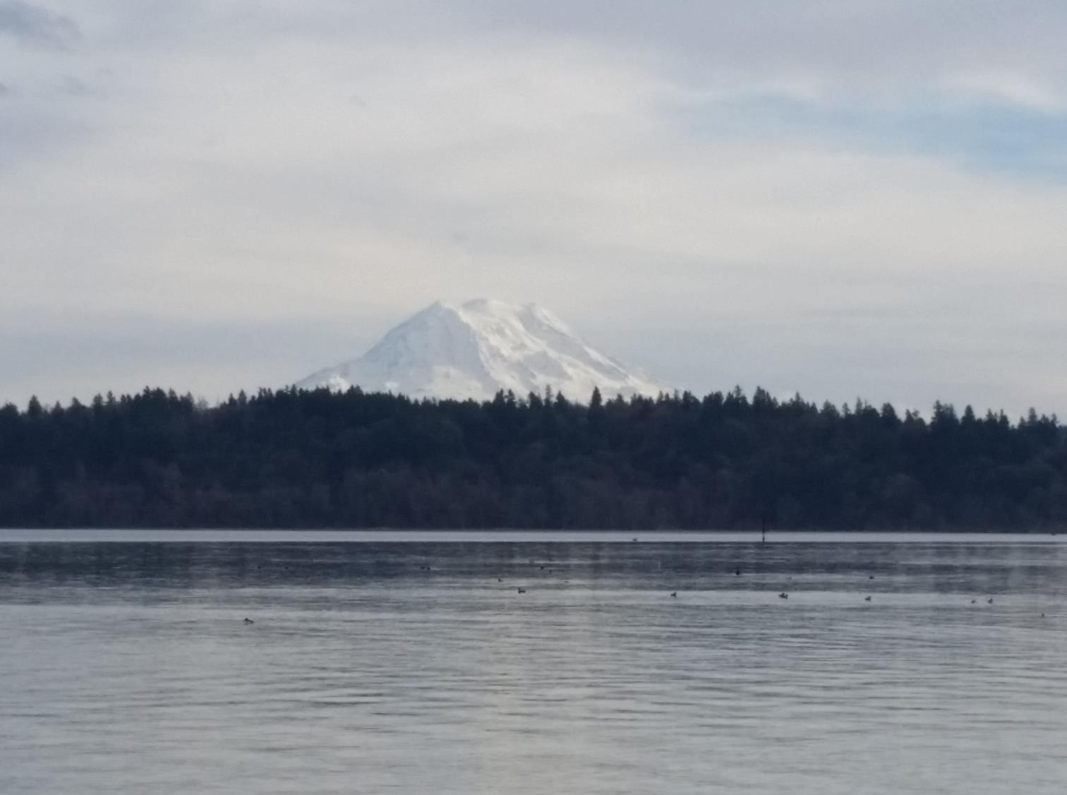

P A C I F I C
H Y B R E E D
Sustaining family shellfish farms through 21st-century breeding science and technology
CONFIDENTIAL – NOT FOR FURTHER DISTRIBUTION

Slide 2

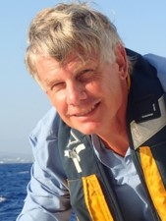
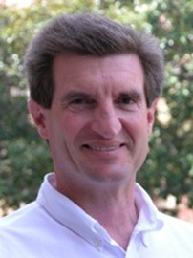

Team
P A C I F I C
H Y B R E E D
Joth P. Davis, PhD
Founder, CEO
Owner- Baywater Shellfish
Faculty, UW School of Fisheries & Aquatic Sciences
PI on numerous restoration and enhancement research projects
Dennis Hedgecock, PhD
Founder, CSO
Offield Professor, USC
International expert on shellfish genetics, genomics, and breeding
135 published papers, over 6000 citations
Jon Kroman
CDO and General Counsel
30+ years legal and organizational development experience
Extensive work with sustainability nonprofits and businesses

Slide 3
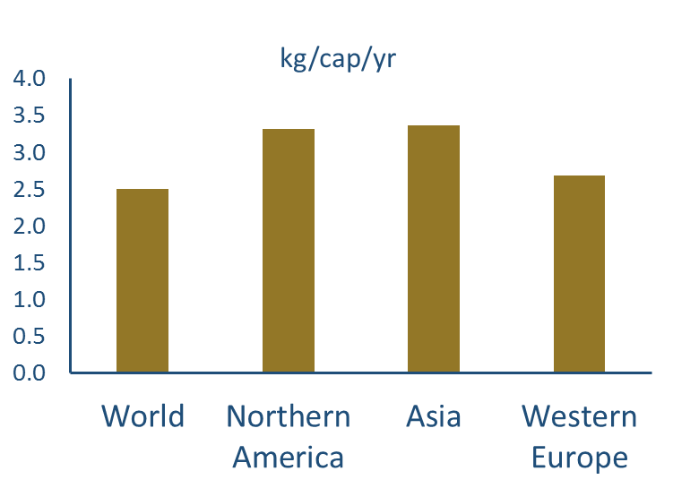
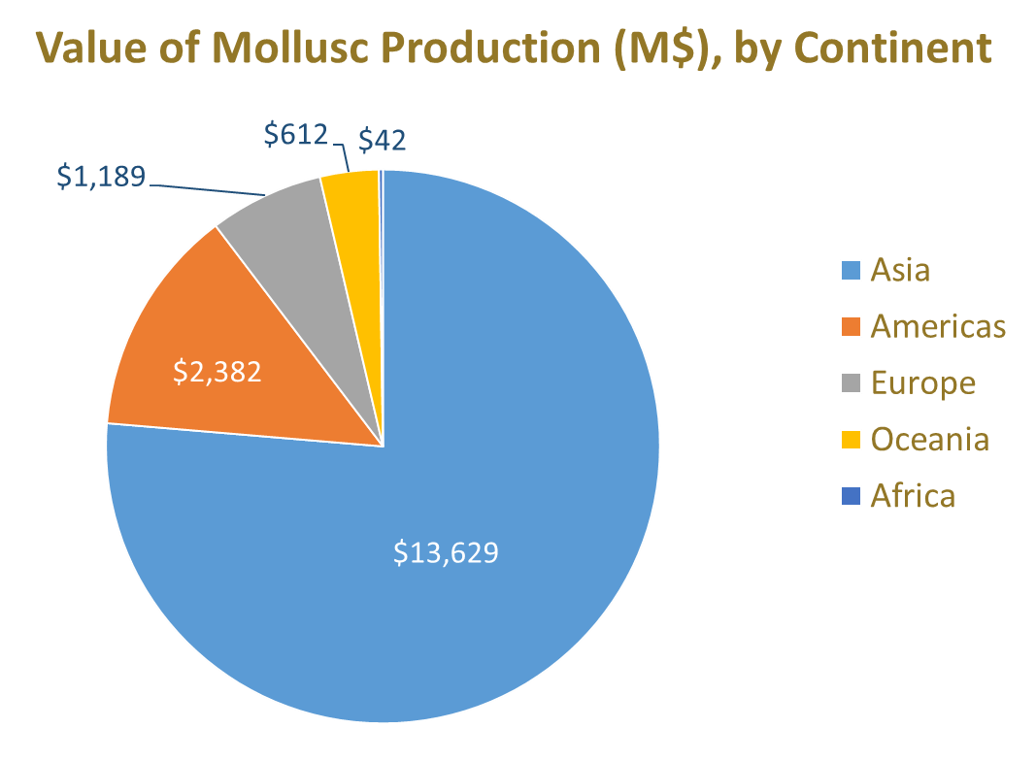
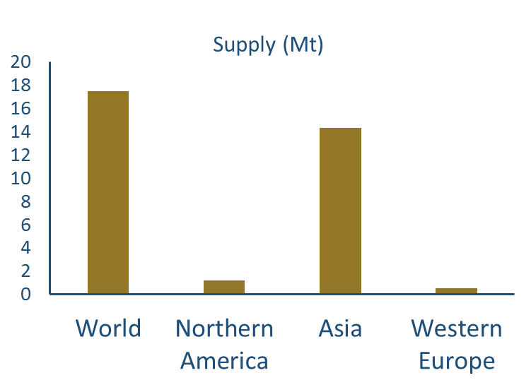
Global shellfish supplies
P A C I F I C
H Y B R E E D

Slide 4
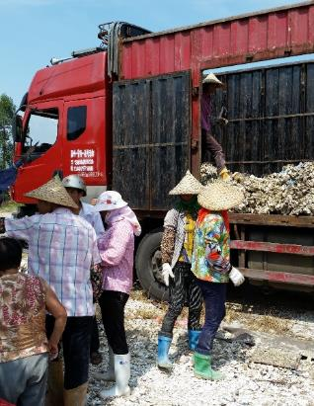
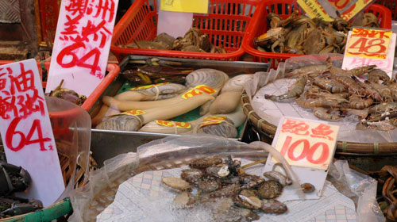
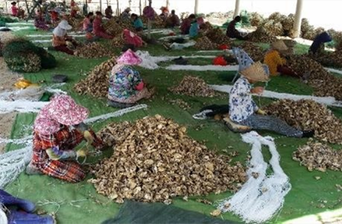
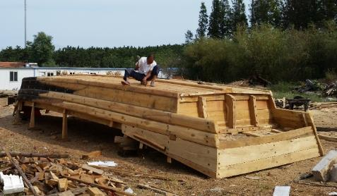
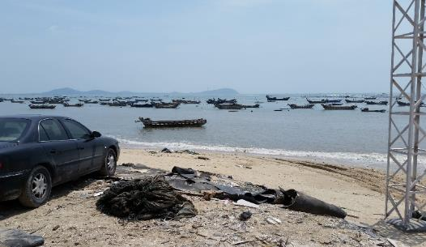
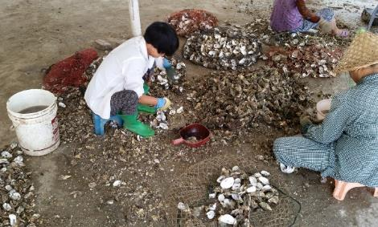
Smallholder aquaculture in developing countries
P A C I F I C
H Y B R E E D
Notes:
90% of aquatic farmers are smallholders in developing countries, who produce just a few tons per farmer, in contrast to the 60 t to 200 t per farmer in the developed world.

Slide 5
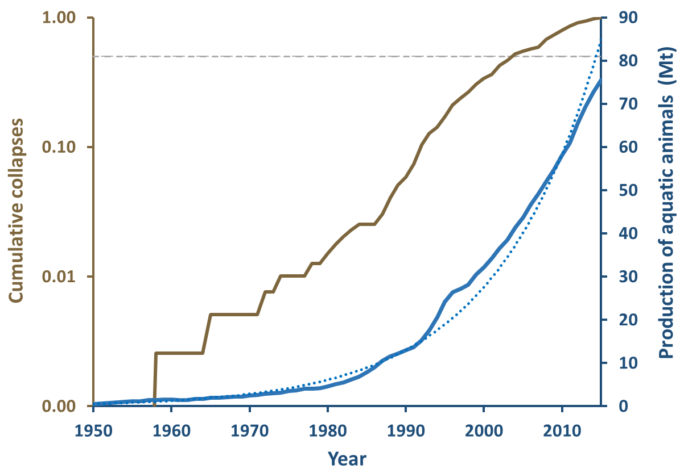
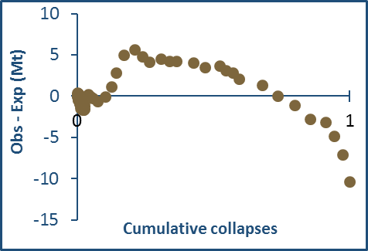
Seafood security threatened by stock collapses
P A C I F I C
H Y B R E E D
1996
2004
2015

Slide 6
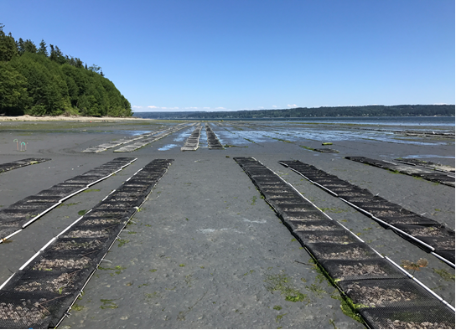
Shellfish aquaculture benefits
Shellfish provide ecosystem services
Nutrient sequestration
Habitat for other marine animals
Filtration, allowing sunlight to reach aquatic plants
No feed, no added nutrients, just natural production
No external energy or freshwater (compared to terrestrial protein production)
Working waterfronts
Supports multigenerational farms

Slide 7
Threats to shellfish aquaculture
P A C I F I C
H Y B R E E D
Acidifying, warming ocean
Limited production capacity in an ever-crowded world with rising sea-levels
Resistance to emerging, virulent diseases
Lack of disciplined breeding programs to generate an adaptive response

Slide 8

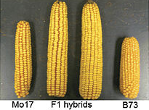
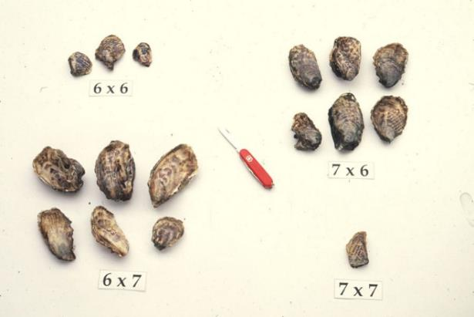
Our solutions are familiar…
P A C I F I C
H Y B R E E D
GMO
Hybrid Corn, Hybrid Shellfish
G. H. Shull, 1908. Proc. ABA
Hedgecock et al., 1995. Aquaculture

Slide 9
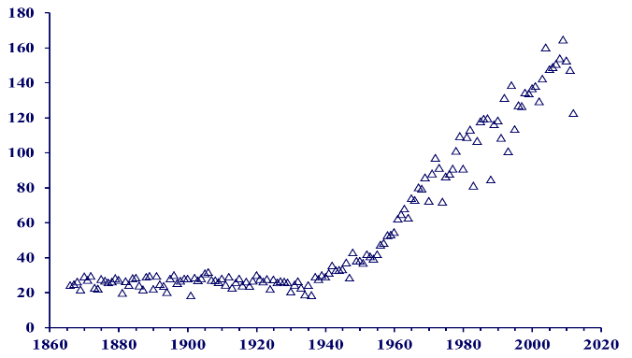
The promise of hybrids
P A C I F I C
H Y B R E E D
Bushels per acre
U.S. Corn, Civil War to 2012
single cross
b=1.77
double cross
Increase shellfish yields and resilience to changing ocean temperature and chemistry
open-pollinated
b=1.04
b=0.02
Year
Hybrid vigor in farmed Pacific oysters
Effect of ocean acidification varies

Slide 10
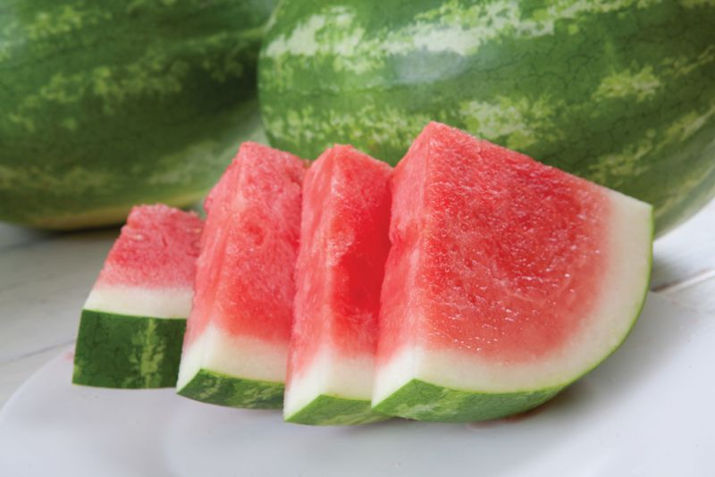
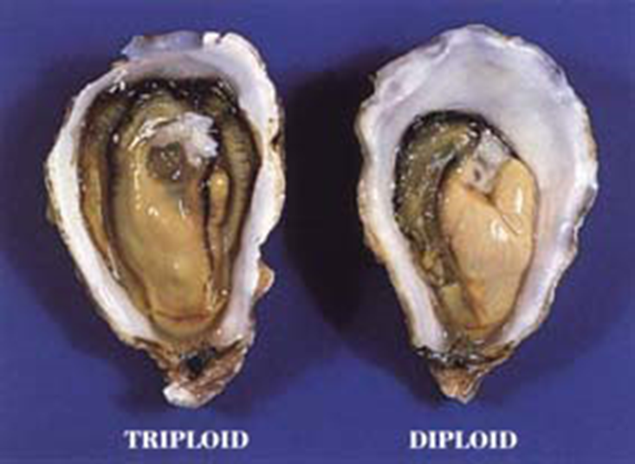
“Seedless” Shellfish
P A C I F I C
H Y B R E E D
Fast growing
Year-round product quality
Safeguards wild stocks & products
Premium price, limited availability
Photo by J. P. Davis, 1986

Slide 11
Intellectual property
P A C I F I C
H Y B R E E D
Trade secrets (small-scale hatchery technology, crossbreeding, polyploidy, control of sex)
Potential patents on biomarkers predicting growth, sex, disease resistance

Slide 12
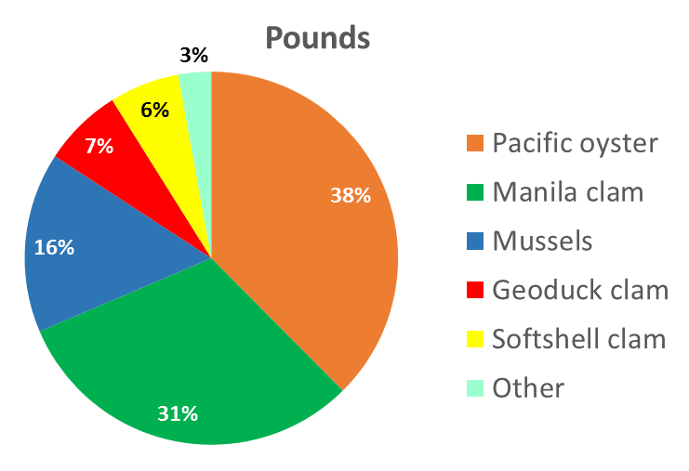
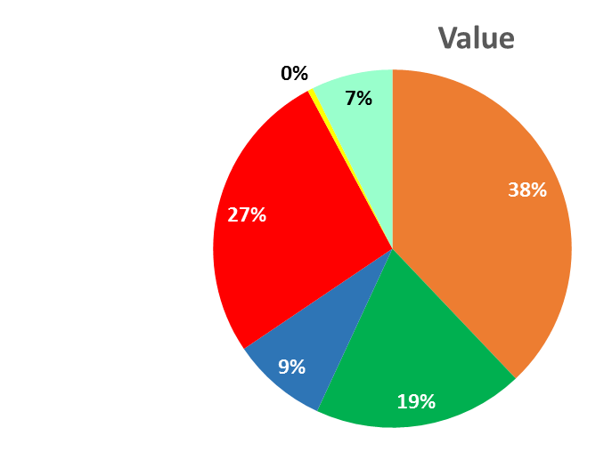
U.S. West Coast shellfish industry
P A C I F I C
H Y B R E E D
From: Shellfish Aquaculture in Washington State: A Final Report to the Washington State Legislature. December 2015. Washington Sea Grant

Slide 13
Competitive advantage
P A C I F I C
H Y B R E E D
Competitors | Multiple species | Sterile triploids | Selection | Hybrids | Genomics
OSU’s MBP |  |  | ✓
4Cs, Inc. |  | ✓
Private consultants |  |  | ✓
In-house programs |  | ✓ | ✓
Pacific Hybreed | ✓ | ✓ | ✓ | ✓ | ✓

Slide 14
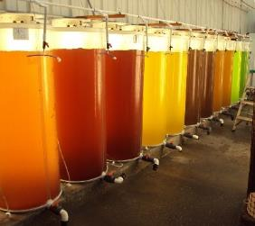
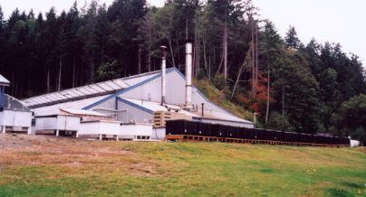
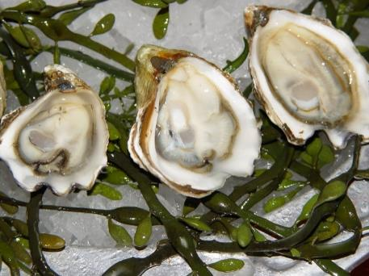
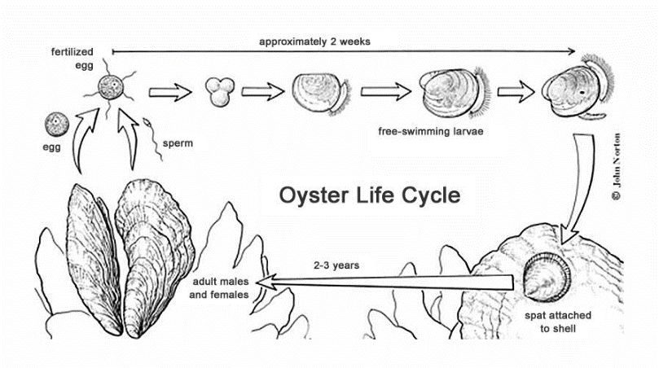
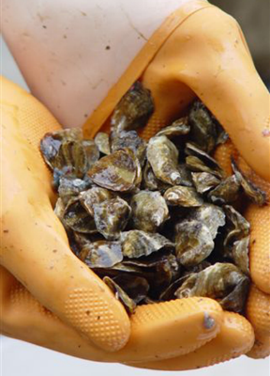
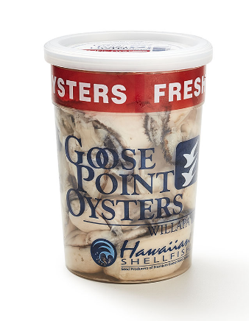
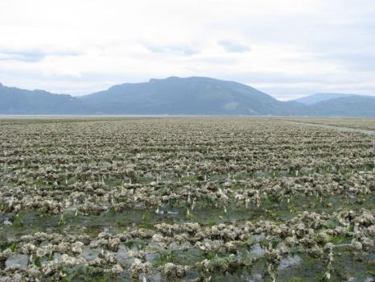
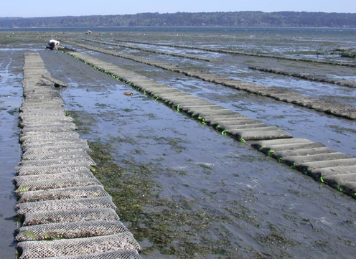
“Setter”
“Seed”
“Broodstock”
Shucked product
Live product

Slide 15
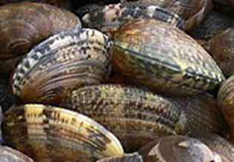
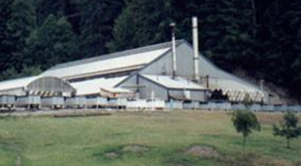
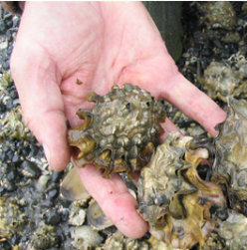
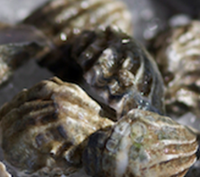
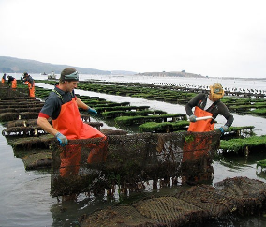
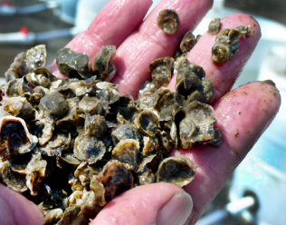
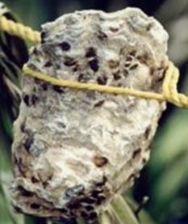
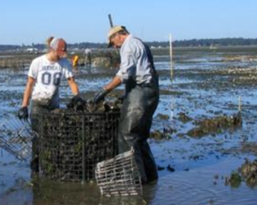
P A C I F I C
H Y B R E E D
What we sell and to whom
Superior broodstock
Commercial hatcheries
Superior single seed
Live shellfish producers
Shucked meat producers
Superior setters

Slide 16
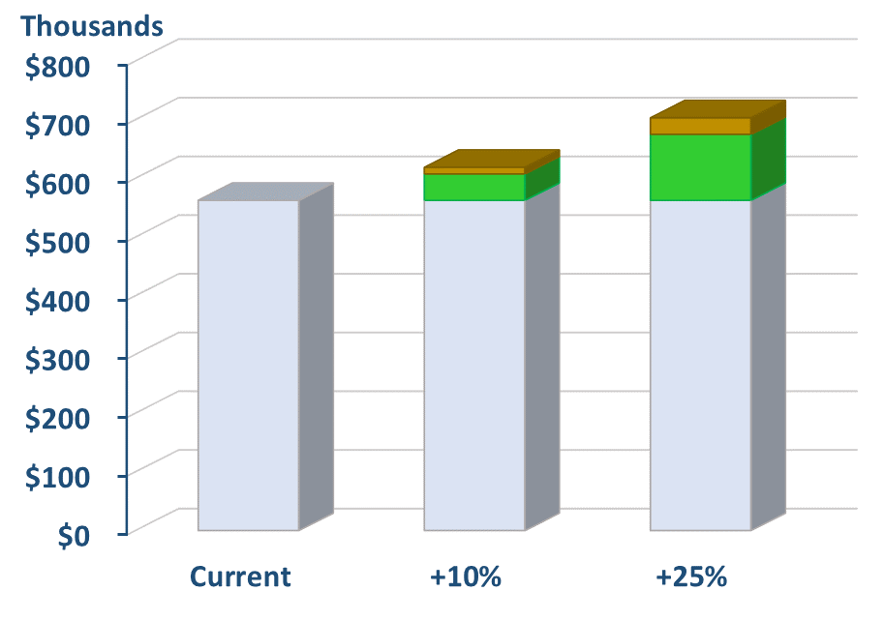
Royalty model at projected scale
P A C I F I C
H Y B R E E D
Pacific Hybreed royalty
20%
Grower share
80%
Over 120 acres*,
royalty on a 10% improvement in yield is $1.35M
royalty on a 25% improvement in yield is $3.38M
* 1000s of acres in production

Slide 17
Revenue streams ($1000s)
P A C I F I C
H Y B R E E D
Source | 2017 | 2018 | 2019 | 2020 | 2021 | 2022 | 2023
Broodstock |  |  | $90 | $246 | $684 | $1,734 | $1,734
Seed/Setters | $174 | $193 | $1,077 | $1,117 | $1,238 | $1,257 | $1,271
Royalties |  | *$562 | $639 | $1,322 | $1,535 | $3,134 | $3,782
Totals | $174 | $755 | $1,806 | $2,685 | $3,457 | $6,125 | $6,787
*Royalty revenue in 4th quarter

Slide 18
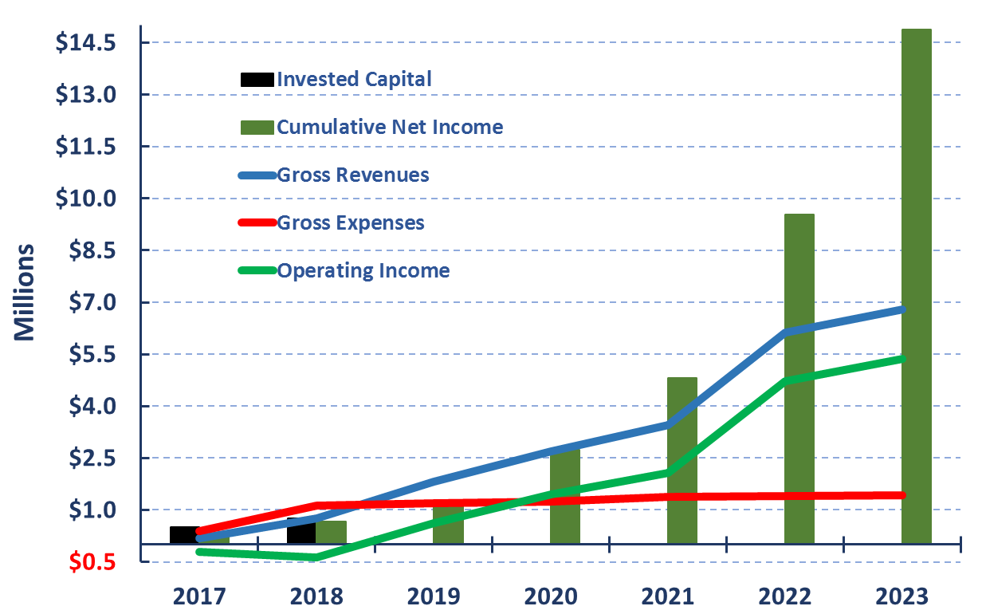
Profitability
P A C I F I C
H Y B R E E D

Slide 19
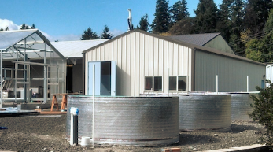
Sales channels
P A C I F I C
H Y B R E E D
Whiskey Creek Shellfish Hatchery
Taylor Shellfish Farms
Coast Seafoods, Pacific Seafood Kona
Hawaiian Shellfish
Pacific Hybreed
Hog Island Oyster
Chuckanut Shellfish
Troutlodge Marine
Legoe Bay Shellfish
Seattle Shellfish
Oregon Oyster Farms
Big Cove Shellfish
OceansAlaska
Island Scallops
Sol Azul
Acuacultura Robles

Slide 20
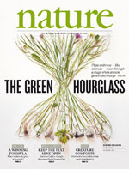



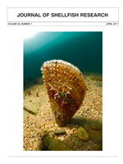
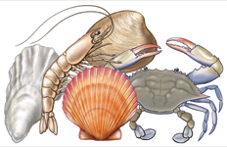

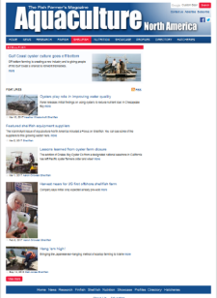
Marketing activities
P A C I F I C
H Y B R E E D
PACIFIC COAST SHELLFISH GROWERS ASSOCIATION
National Shellfisheries Association
Established 1908

Slide 21











Partners & resources
P A C I F I C
H Y B R E E D

Slide 22
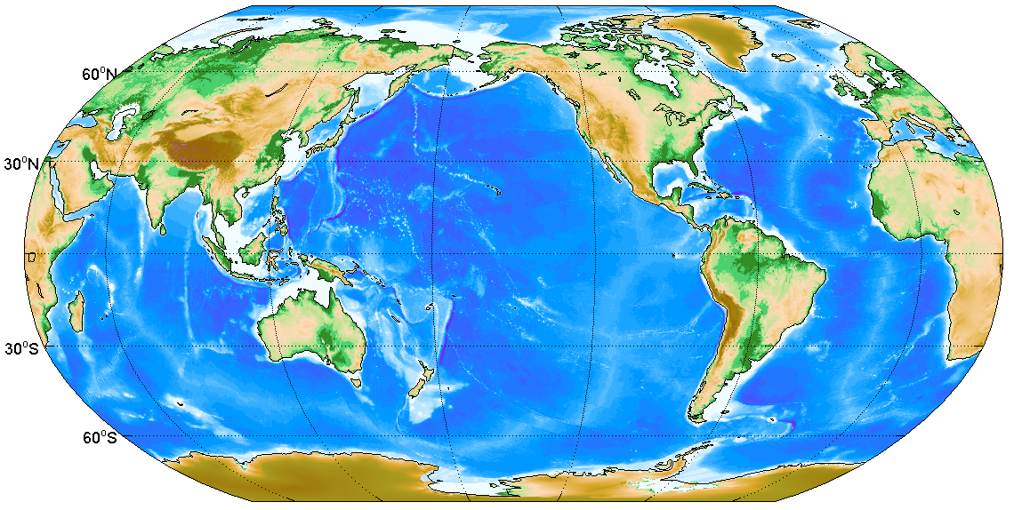
International opportunity ($18B global market)
P A C I F I C
H Y B R E E D

Slide 23
Convertible note offering
P A C I F I C
H Y B R E E D
Terms
$500,000 total
8% accrued interest; 18-month maturity
Automatic conversion on next round ($750,000 priced equity) at discounted price (80%)
$5M valuation cap
Optional conversion at valuation cap on or before maturity if no prior equity sale
$25,000 minimum investment
Use of Proceeds
Hire production staff and other key employees
Acquire Manchester facilities & equipment from Baywater
Create and sell initial products
Design Hilo and expanded Manchester facilities
Fund joint venture production with Baywater

